Slide 1
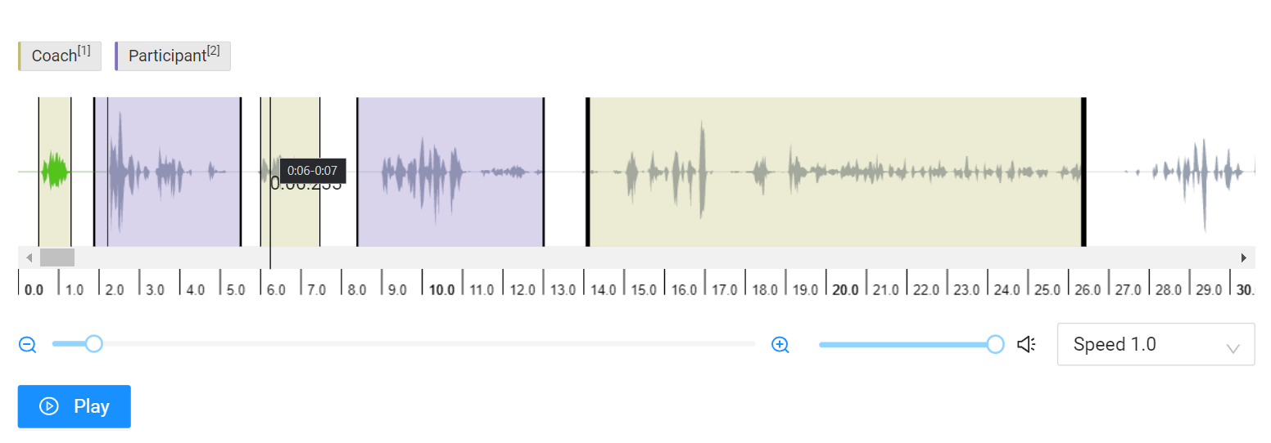
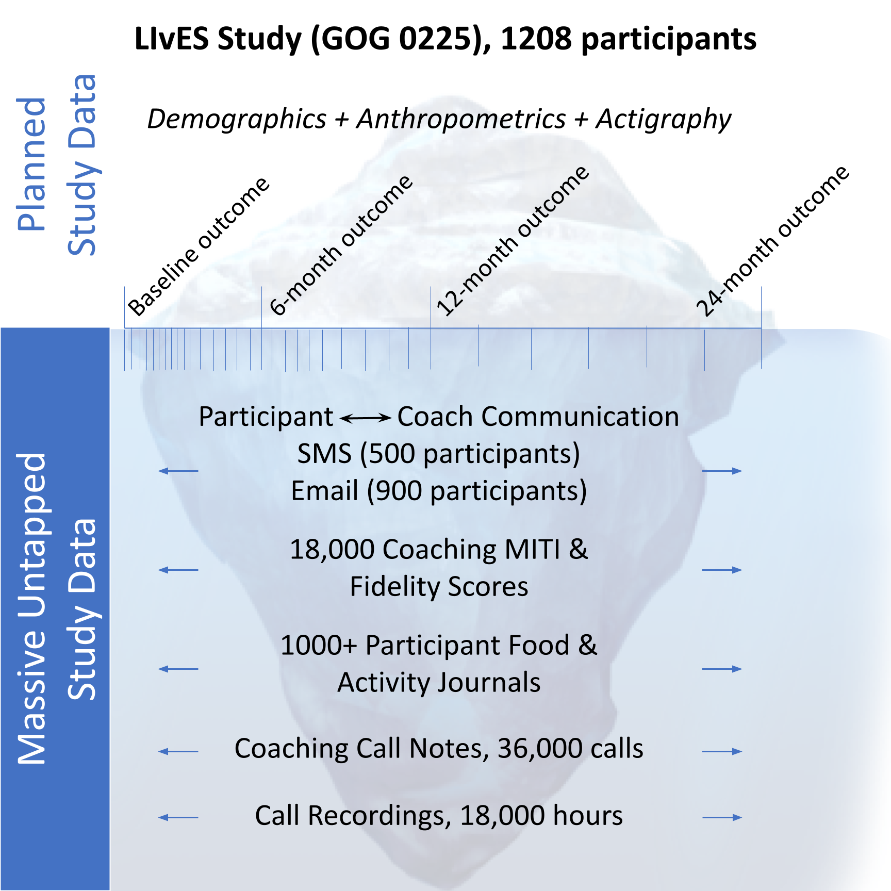
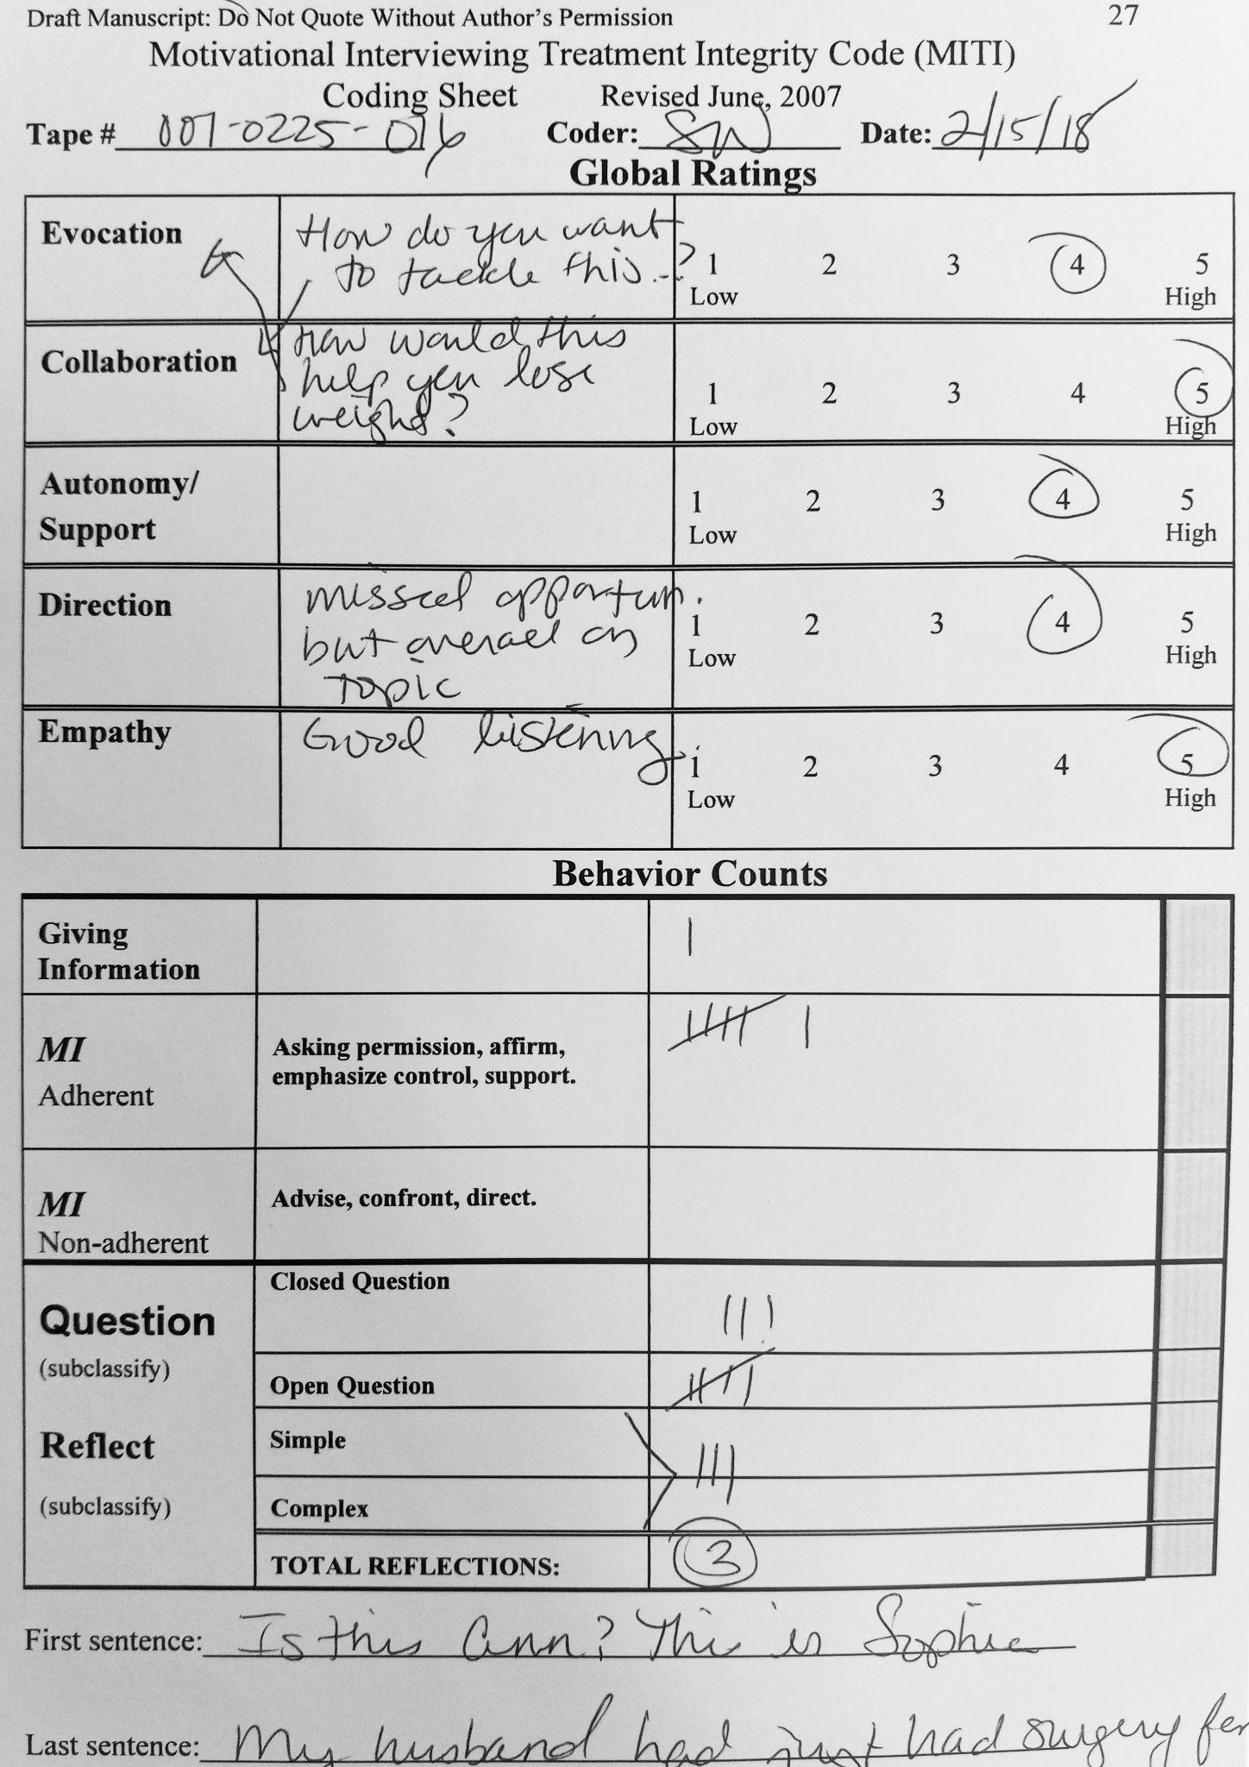
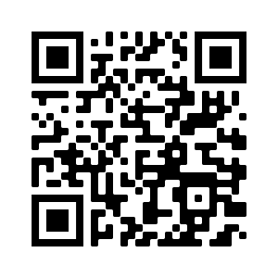
Comprehensive data re-usability is critical in the current ecosystem of machine learning and artificial intelligence
Actionable data management foresight can help extract value from non-traditional sources of data from behavioral health interventions
LESSONS LEARNED FROM A SECONDARY ANALYSIS USING NATURAL LANGUAGE PROCESSING AND MACHINE LEARNING FROM A LIFESTYLE INTERVENTION
Non-Cognitive Predictors of Student Success: A Predictive Validity Comparison Between Domestic and International Students
BACKGROUND:
Fidelity automation and prediction of lifestyle behavioral outcomes through natural language processing (NLP) and machine learning (ML) were met with challenges related to the re-usability of the LIvES Study (GOG 0225) data.
CHALLENGES: Numerous costly measures taken to re-use our data:
Natural Language Processing & Machine Learning compatible annotation interface
Challenge | Cost
Audio files and fidelity data not linked to outcomes | ~240 hrs of manual work + data loss
Lack of planning for data derivatives | ~170 hrs incl. re-annotation
Incomplete socio-cultural background data | Missed opportunities
Personally identifiable information | Missed opportunities
Consent | 40 hrs of work + data loss
Natural Language Processing & Machine Learning incompatible annotation interface
CONCLUSION:
To take advantage of machine learning, natural language processing and artificial intelligence, behavioral interventions should engage the support of a data scientist in the study design planning stage and throughout data collection.
LESSONS LEARNED:
Ensure unique identifiers link all related data
Plan for machine-friendly data structure and format
Co-collect data and derivatives
Collect culturally relevant data
Create data de-identification protocols for all data types
Consent all the people involved, not only participants
Sarah Freylersythe,^{1,4} Rebecca Sharp,⁷ John Culnan,⁵ Damian Y. Romero Diaz,³ Yiyun Zhao,⁵ G. Hagan Franks,⁶ Remo Nitschke,⁵ Steven J. Bethard,² Tracy E. Crane⁴
LIvES Study (GOG 0225) NCT00719303
BMISR UACC P30 CA023074
NLP/ML NIH/NCI 1R21CA256680-01
Notes:
Abstract here: https://docs.google.com/document/d/1-FCmW81Ost7_AeRWhVkCF9xGIRPHY5HdUfUsbWgF8n8/edit
GitHub website through the QR code and url: https://github.com/clulab/SBM_2022_LIvES
Data challenges paper here: https://docs.google.com/document/d/1nKZbLhId7amXVIAA2UPEgsiGJO9o_OyO6G8bxGKqBU0/edit#
NLP study goals:
How can we automate monitoring of health coaching for study fidelity?
What language used in health coaching actually leads to behavior change?
How can we make the feedback loop for health coaches tighter?

